Slide 1
Online Library Management System
6th Semester Project

Slide 2
Introduction
“Sleek, Modern and Efficient Library in your hands”
Ashbel Ashish Lama
Sebi Mahajan

Slide 3
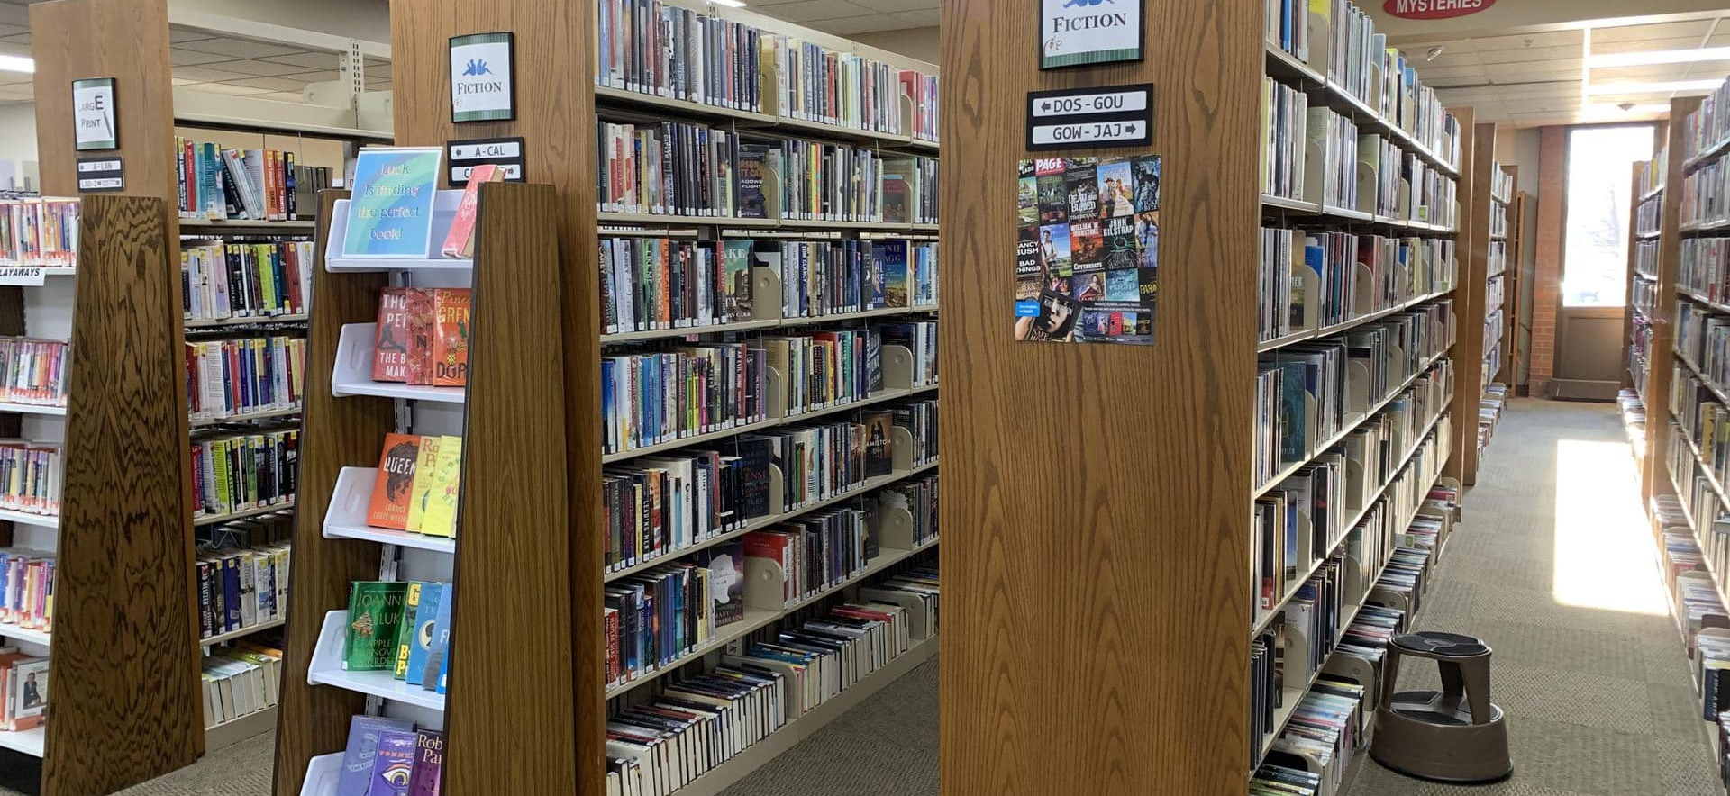
Online Library Management System
About the project
This is Our Background
Collection of Knowledge
Fastest Growing Industry
Removing the Limitations of Traditional Libraries
01
Problems
02
Objectives
03
Scope
Manual work takes time
Not a job for one man
Improper Record of Book Information
Translating Traditional Library to Modern One
Computerized System to maintain the library
To make online book issue
Library
User Log-In Page
Book Register

Slide 4
Feasibility Study
01
02
03
04
Economic Feasibility
Operational Feasibility
Technical Feasibility
Cultural Feasibility
To check how much cost is incurred
To look whether it is operational or not
To check whether it is user-friendly
Whether it is cross-platform or not
To look at the correlation between End-user and the system

Slide 5
05
06
Legal Feasibility
Schedule Feasibility
Does it has licensing issues?
Shown through GANTT Chart

Slide 6
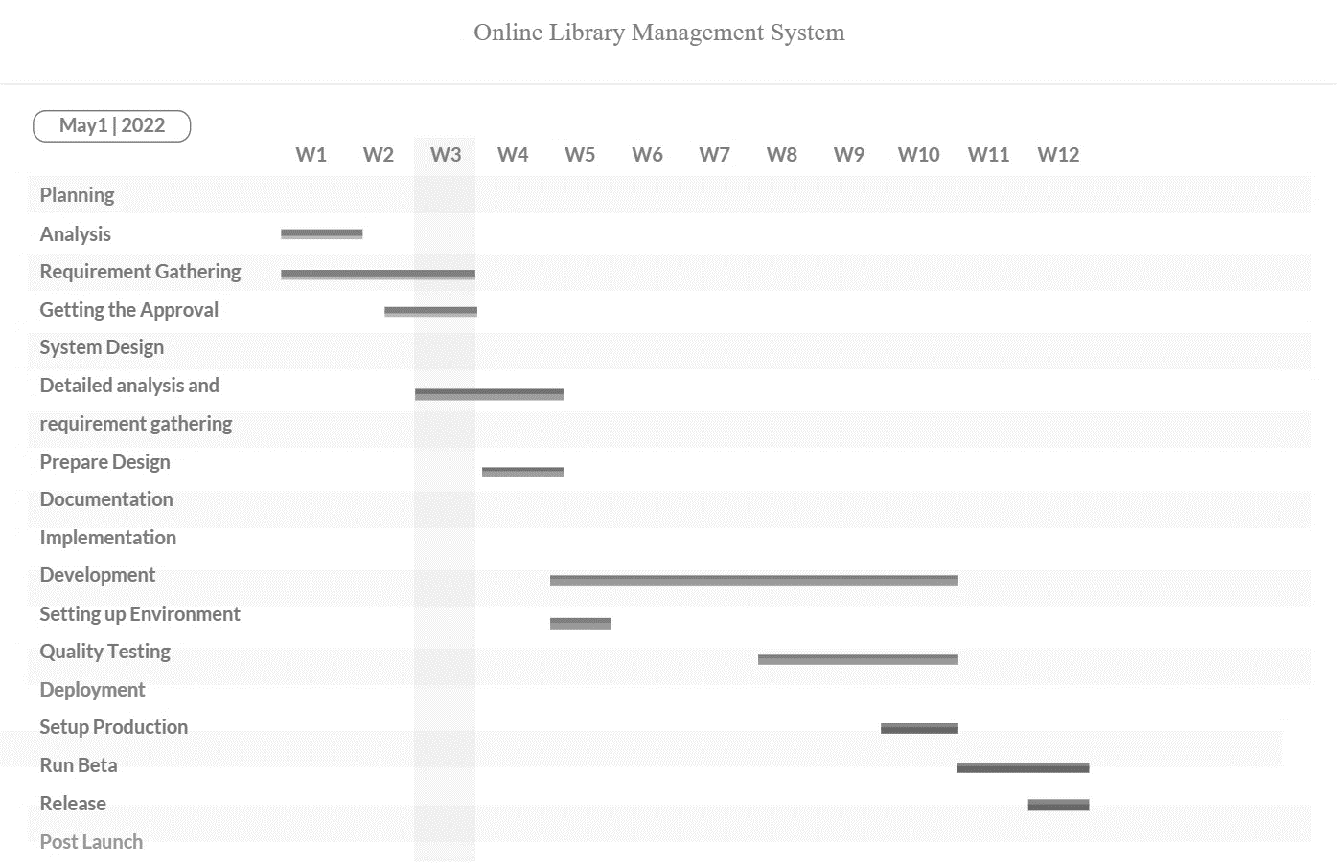
GANTT AND PERL CHART

Slide 7
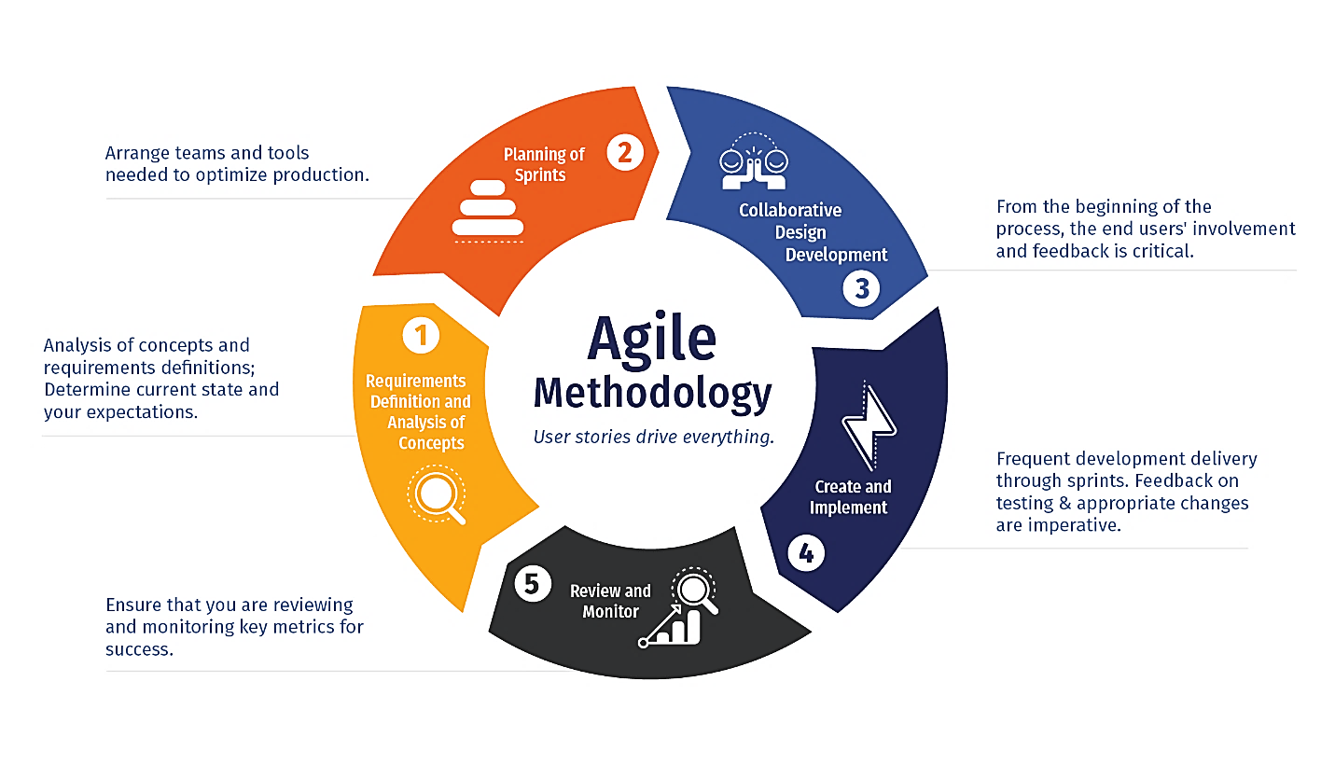
Agile Methodology

Slide 8
Phases of Agile Model
Requirements gathering
Design the requirements
Construction/Iteration
Testing/Quality assurance
Deployment
Feedback
Advantages and Disadvantages of Agile Model

Slide 9
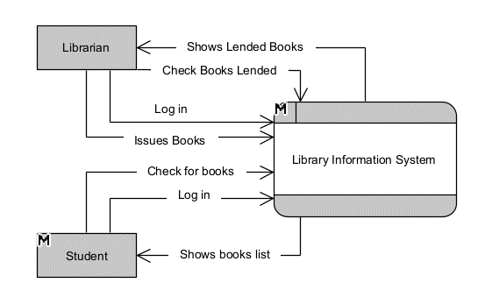
DFD Diagram
Level 0 DFD Diagram (Context Diagram)

Slide 10
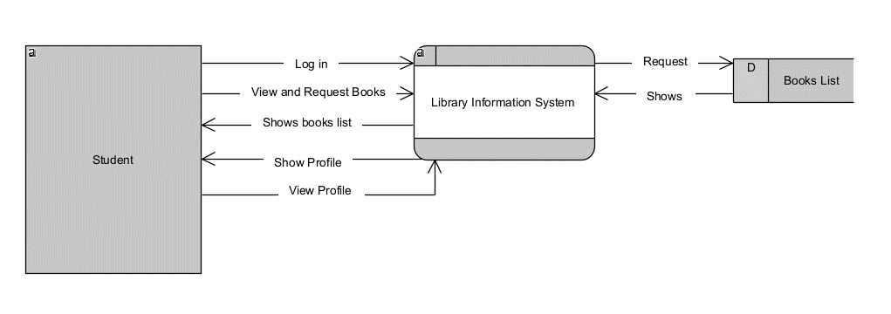
DFD Diagram
Level 1 DFD Diagram (Student)

Slide 11
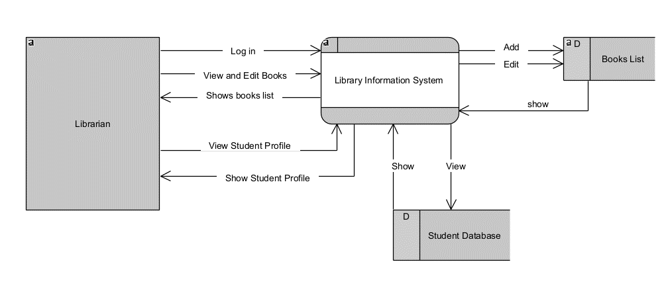
DFD Diagram
Level 1 DFD Diagram (Librarian)

Slide 12
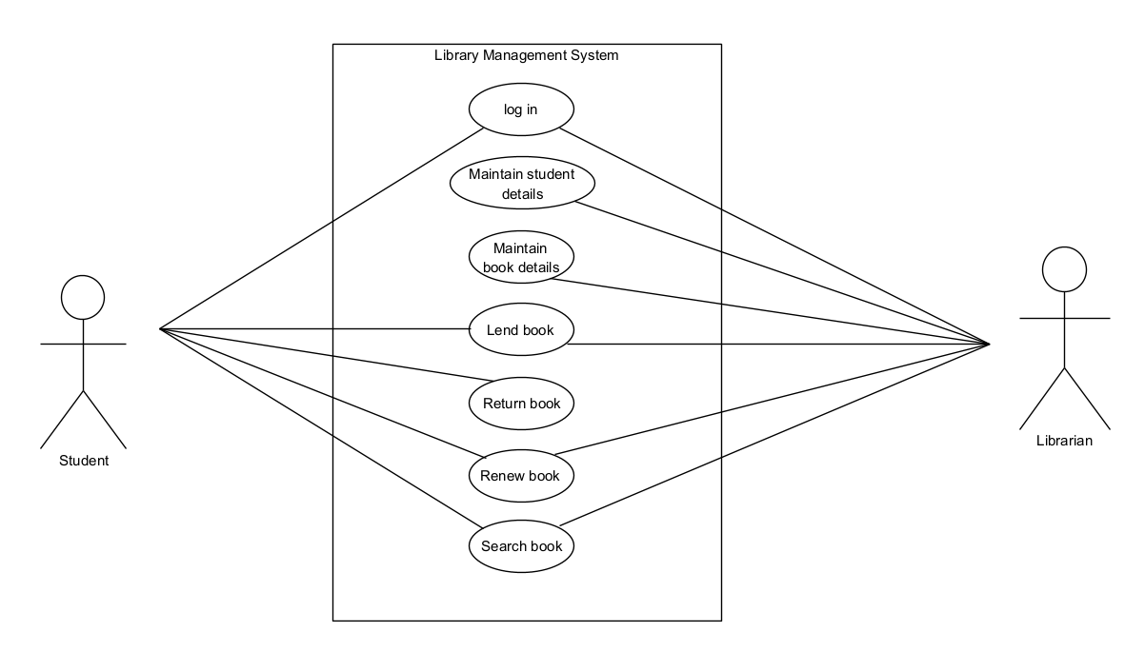
Use-Case Diagram

Slide 13
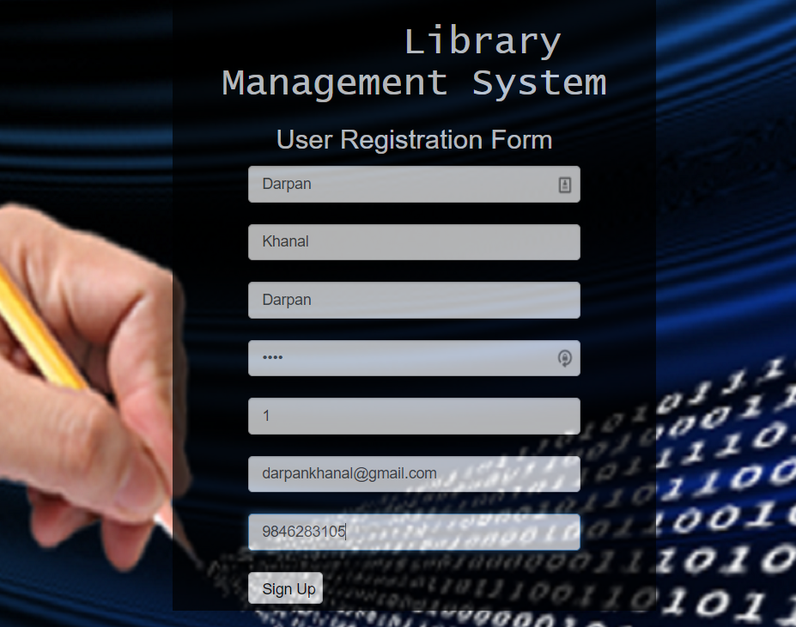
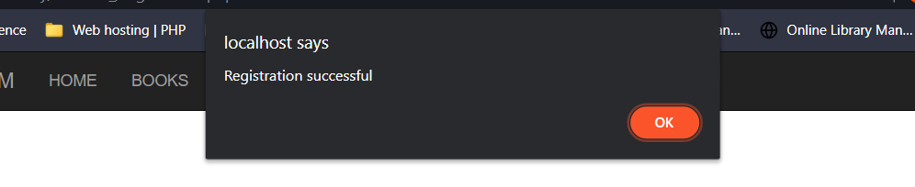
Test Cases
Login test case

Slide 14
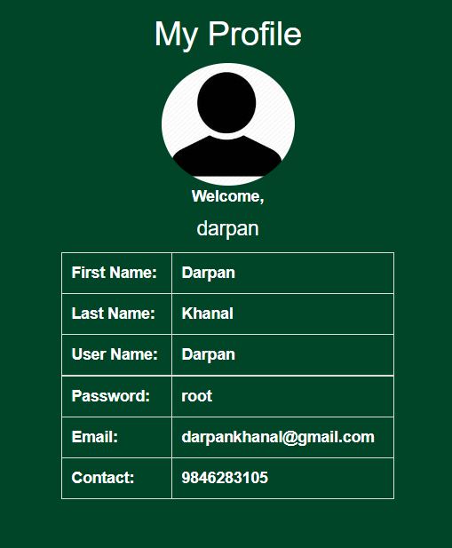
Test Cases
Profile view

Slide 15
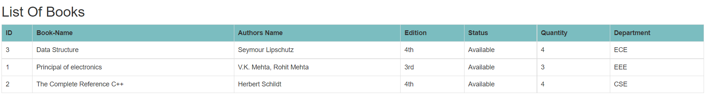
Test Cases
Book view

Slide 16
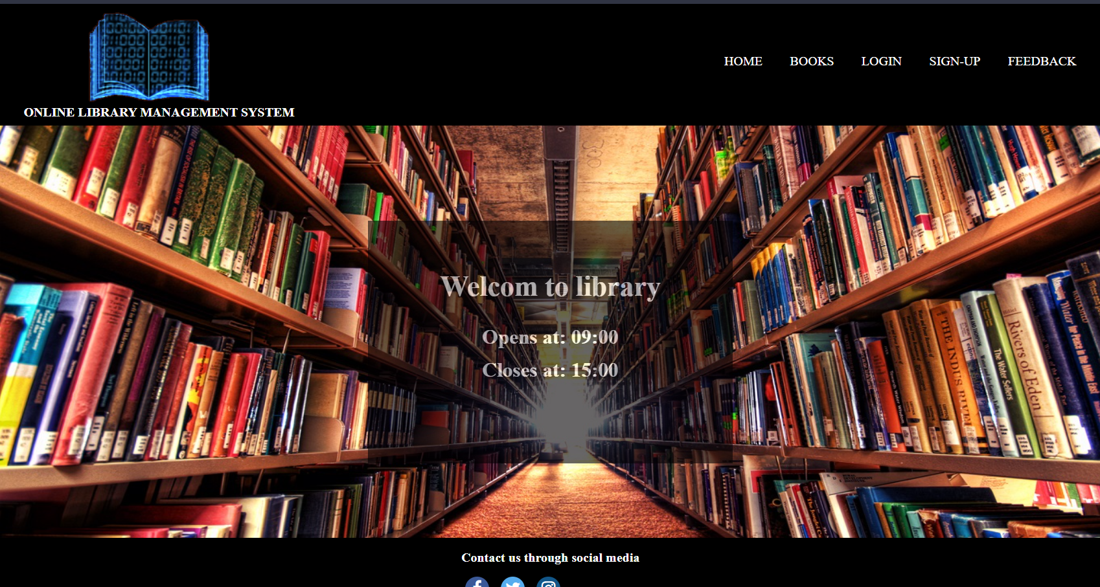
Demonstration of Library Management System

Slide 17
Conclusion and Future Extension
Our further plans for the development of library management system include:
Adding the functionality of calculating fine
Adding the functionality of making detailed reports
Adding the functionality of receiving and sending feedbacks

Slide 18
Thank You
For Your Attention

